Slide 1

MINOR PROJECT - II
ON
Co Work: CoWorking Spaces
Management Application
(MCA – II SEMESTER; BATCH 2025-27)
Project Mentors
Dr. Sania Kukkar
Dr. Sunil Pratap Singh
Presentation by
Vaibhav Pathak (06911604425)
Devansh Patidar (09911604425)
Mayan Wadhawan (10811604425)
15th May 2026
Notes:
<number>

Slide 2
Contents
Problem Description
Aim and Objectives
Methodology and Technology Used for Project Development
Project Classes
Design Documents (Use Case, Data Flow Diagram, Entity-Relation Diagram, etc.)
Operating Structure of project
Screenshots
Conclusion
Future Scope
Bibliography

Slide 3
Problem Description
The current market lacks a unified platform that aggregates coworking spaces while fostering open competition for transparent price discovery, leaving a significant gap for both consumers and providers. Our project addresses this by offering a comprehensive, user-friendly solution that streamlines the booking process for professionals while providing space owners with integrated tools to efficiently manage their day-to-day operations.

Slide 4
Aim and Objectives
Aim:
  To develop a robust web application that aggregate CoWorking Spaces Market using ReactJS, Java’s SpringBoot, MongoDB.
Objectives:
  To allow users to search, select and discover Co Working Spaces around them
  To see the review/ratings and to review/rate Spaces
  Enable users to add smaller services in the form of Add-ons before or during their allotted time.

Slide 5
Methodology and Technology Used
Methodology used for Project Development:
Stakeholder Mapping: Identify needs for both "Space Seekers" (consumers) and "Space Providers" (businesses).
Feature Prioritization: Define core functionalities like real-time search, competitive bidding/pricing, and booking management.
Data Modeling: Determine the document structure for MongoDB to handle varied amenities and dynamic pricing.

Slide 6
Methodology and Technology Used
Methodology used for Project Development:
Microservices Architecture: Decouple the user-facing marketplace from the provider-focused management ERP.
API Strategy: Design RESTful endpoints in Spring Boot for seamless communication between the React frontend and MongoDB.
Security Framework: Implement JWT-based authentication and Role-Based Access Control (RBAC) to separate consumer and provider data.

Slide 7
Methodology and Technology Used
Technology used for Project Development:
  Java (JDK 21) – Core Backend programming language
  SpringBoot (4.0.6) – Backend
  MongoDB Atlas – Cloud based DBMS
  ReactJS – Frontend
  IDEs used: IntelliJ / VSCodiums

Slide 8
Project Modules
Project Modules:
User Authentication & Profile Module: Gateway to the application, managing identities and security.
Marketplace & Discovery Module: "Search Engine" of the platform. (GeoSpacialSearch, Filtering Engine)
Booking & Transaction Module: Handles Real-Time Availability, Pricing Engine and Payment Transactions.
Provider Operations (ERP) Module: The internal tool for space owners to manage their business. (Inventory Management, Operational Dashboard, Maintenance Tracking)

Slide 9
System Design

Slide 10
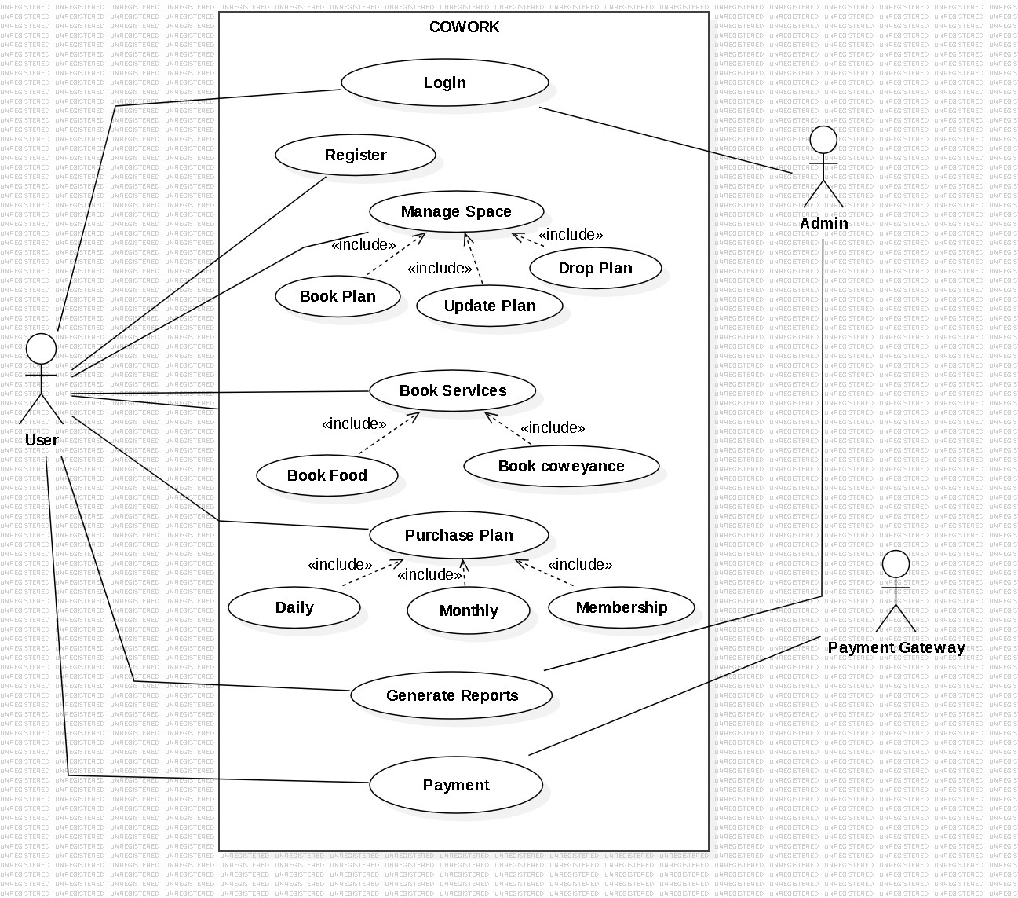
Use Case Diagram

Slide 11
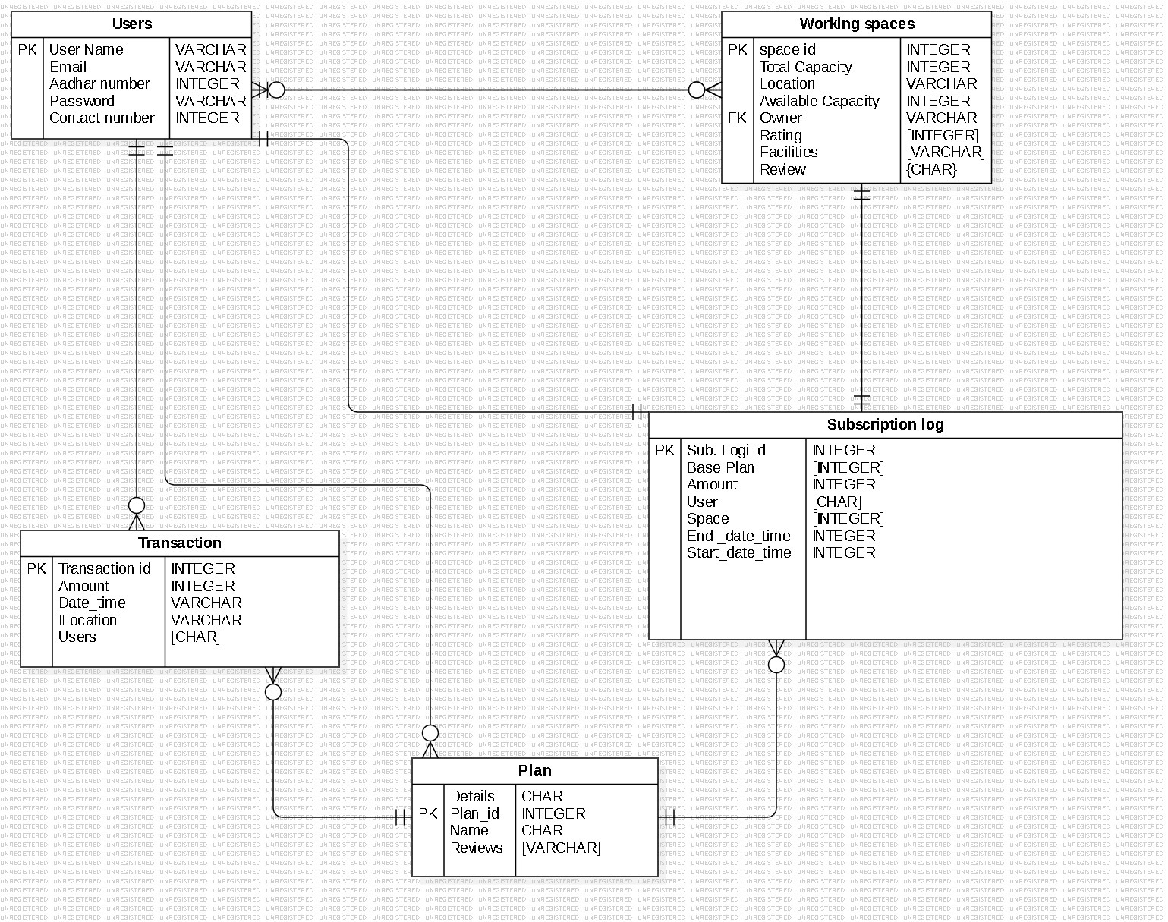
Entity-Relationship (ER) Diagram

Slide 12
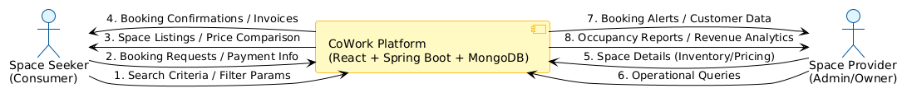
Data Flow Diagram (Level - 0)

Slide 13
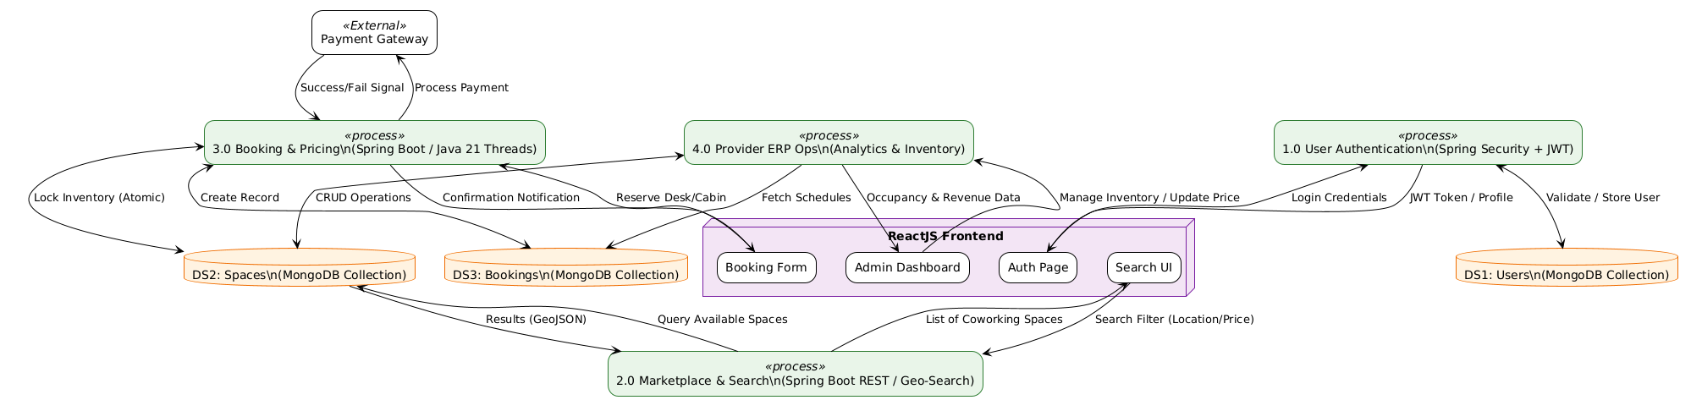
Data Flow Diagram (Level - 1)

Slide 14
Operating Structure of Project
  API Interaction: React sends asynchronous HTTP requests via Axios/Fetch to Spring Boot REST endpoints.
  Data Processing: Spring Boot handles business logic and interacts with MongoDB, returning data in JSON format.
  Dynamic Rendering: React receives JSON responses to update the UI and manage state without refreshing.

Slide 15
Screenshots

Slide 16
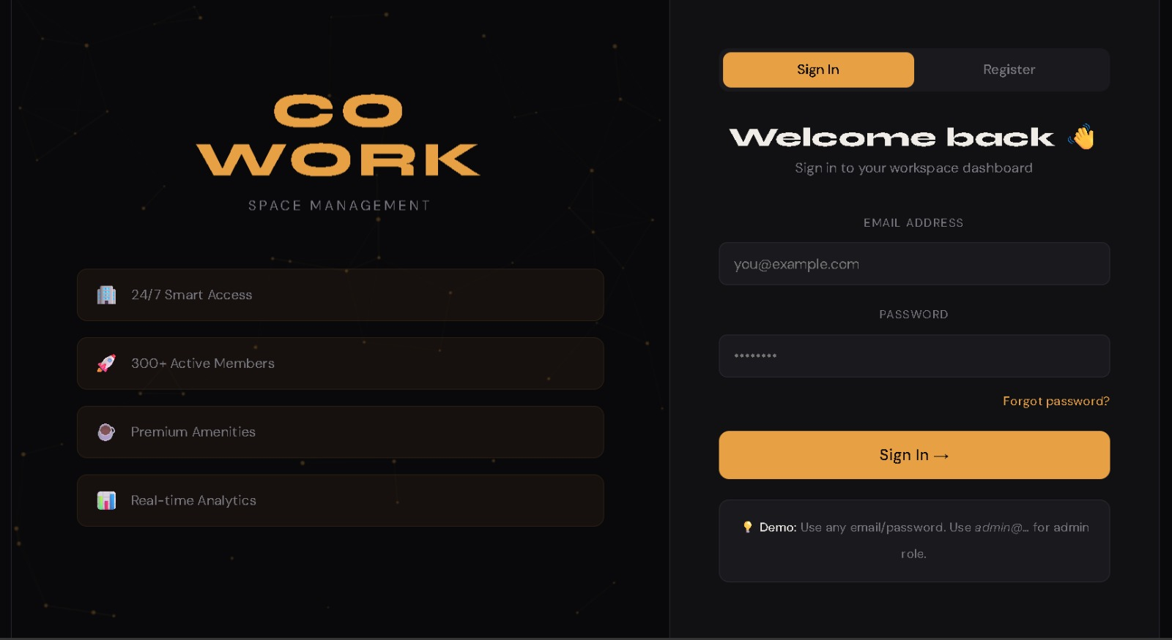
Screenshot - 1

Slide 17
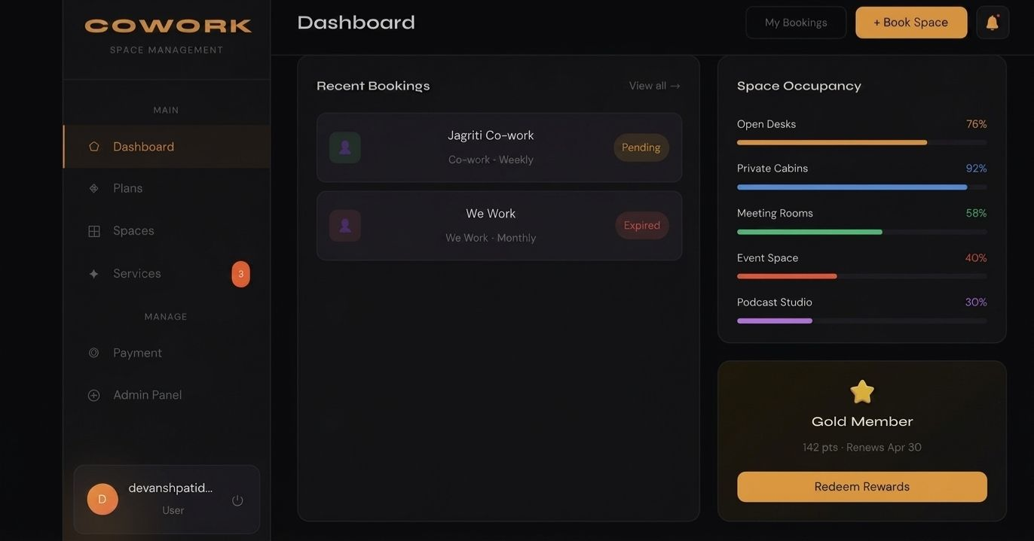
Screenshot - 2

Slide 18
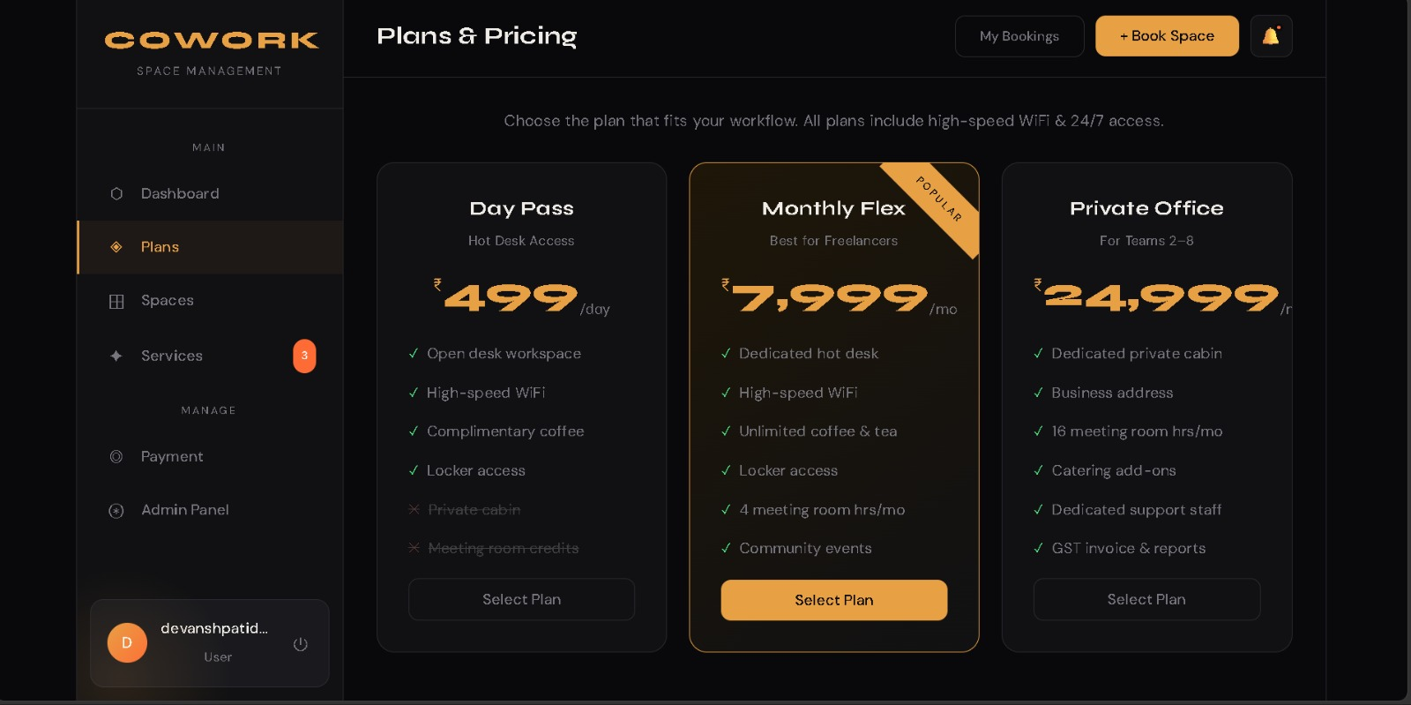
Screenshot - 3

Slide 19
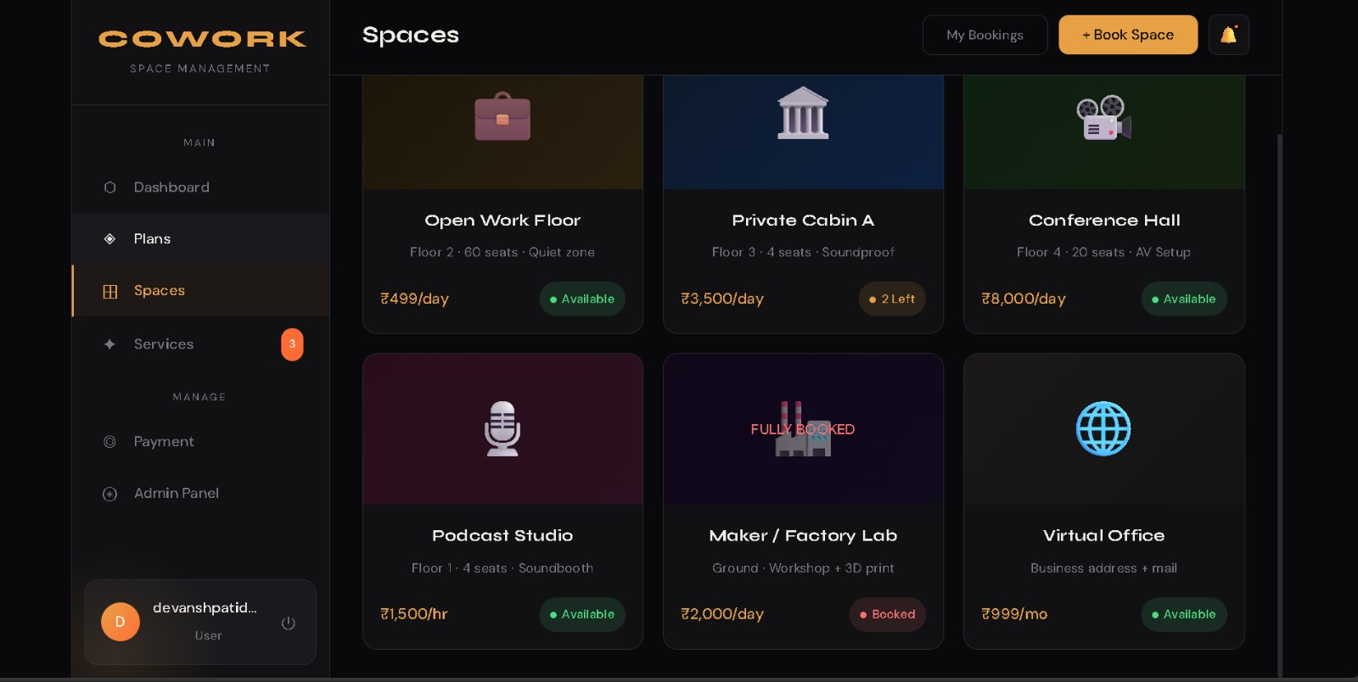
Screenshot - 4

Slide 20
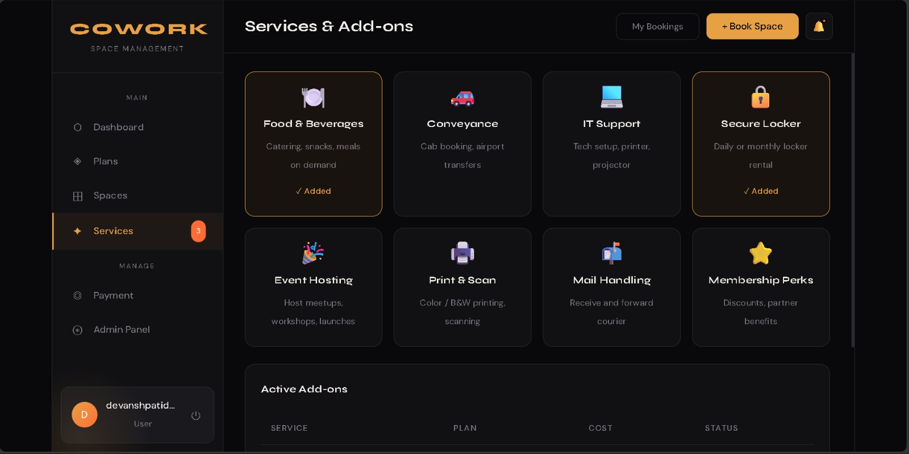
Screenshot - 5

Slide 21
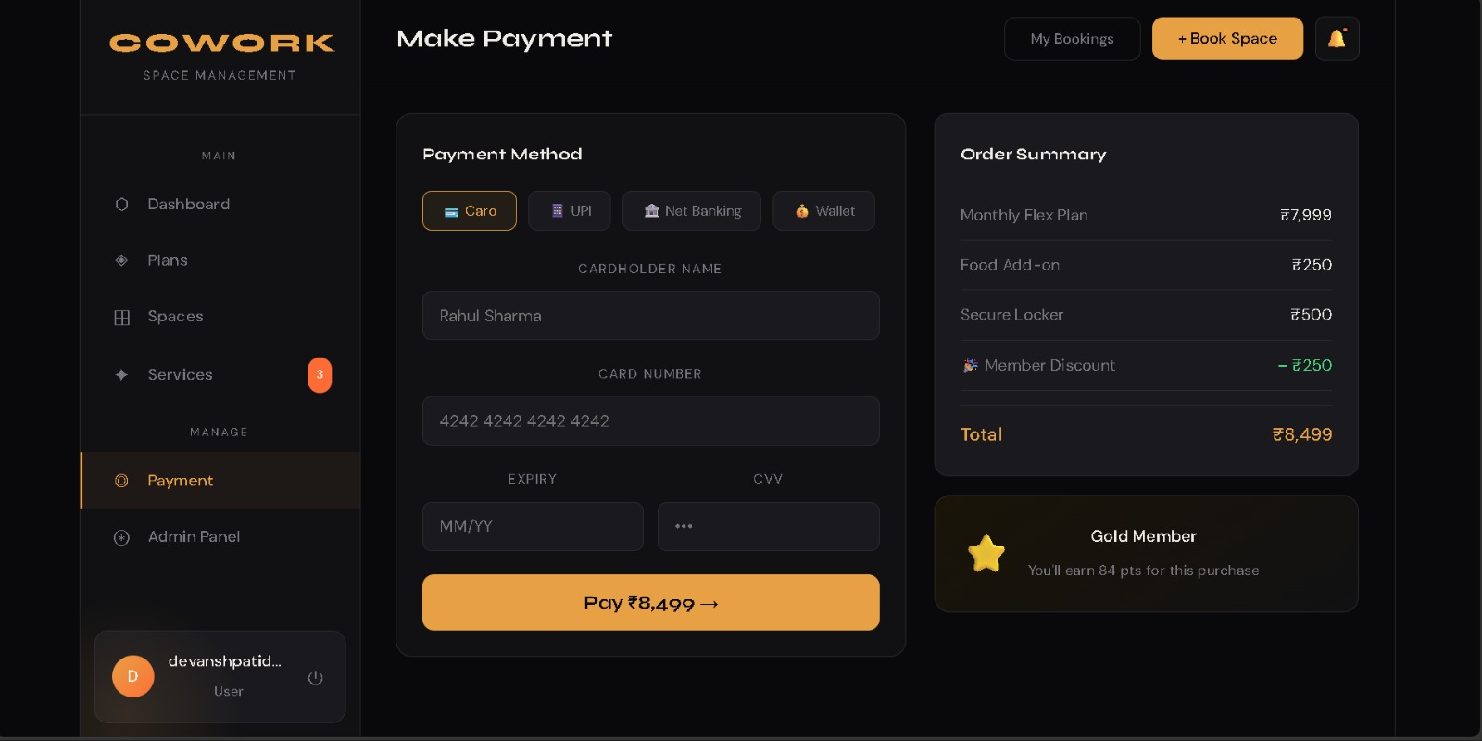
Screenshot - 6

Slide 22
Future Scope
AI Pricing Optimization: Predictive analytics for real-time rate discovery.
Mobile Expansion: Native React Native apps for on-the-go booking.
IoT Smart Access: Automated door locks and energy management.
AR Workspace Tours: Immersive 3D virtual space previews.

